Slide 1
Valentina Moretti Mattia Colbertaldo NBODY

Slide 2
Work done
From 2D to 3D
Possibility of using different interaction forces: repulsive, gravitational, gravitational with assist, coulomb force (std::shared_ptr<AbstractForce> force;)
Cuda
Possibility of using different collision types in cuda and in Openmp

Slide 3
NBODY
An n-body simulation is a simulation of a system of particles under the influence of physical forces like gravity.
Particle-particle interactions − simple, highly data parallel Algorithm
Forces of each particle can be computed independently
Accumulate results
Add accumulated results to previous position of particles
New position used as input to the next time step to calculate new forces acting between particles

Slide 4
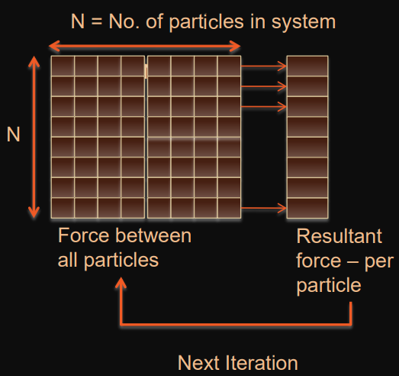

Slide 5
OPENMP

Slide 6
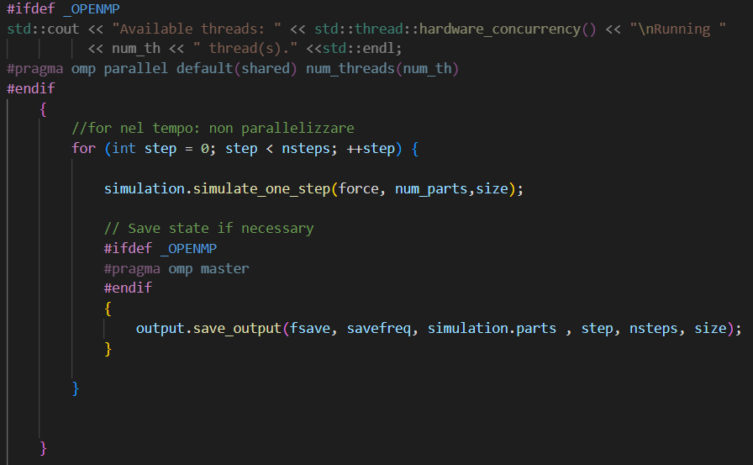
Parallelization is achieved in this way:
In main we have a temporal for loop which we don’t want to be parallel because it is referring about subsequent temporal window: we will save the positions of all particles once every “nstep” on an output file.

Slide 7
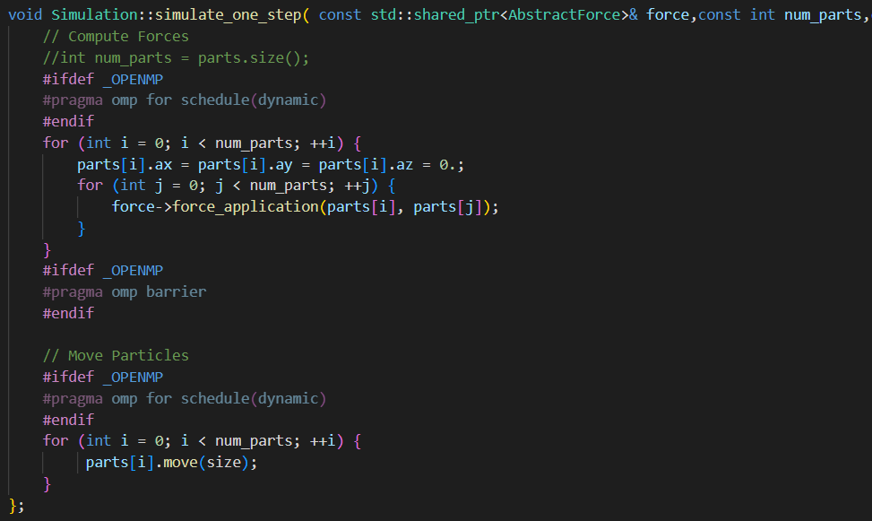
Parallelization is achieved in this way:
In simulate_one_step we perform two parallel loops: one for the calculation of the overall force applied on a particle p as the result of the interaction with all the other forces and one to change the positions of all particles.
Between the two loops we need a barrier to ensure that the final force to be applied on all particles is calculated before moving the particle itself.

Slide 8
MPI

Slide 9
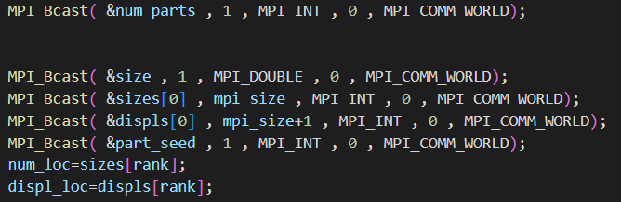
Communication:
In main are broadcasted all the info needed by all processes

Slide 10
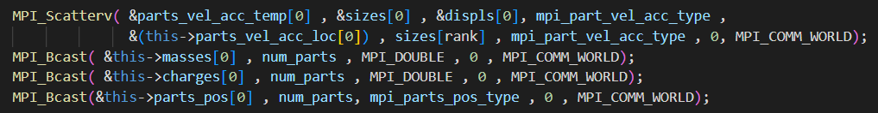
Communication:
In init_particles (in Simulation.cpp):

Slide 11
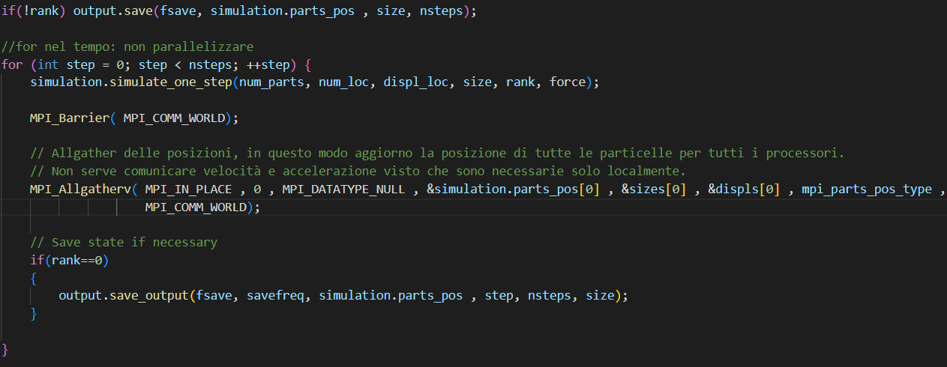
Communication:
In init_particles (in Simulation.cpp):

Slide 12
Work scheduling:
Each process calculate the resulting force and movement of a subset of particles ( given by sizes[rank] and displs[rank]). In order to do this, each process needs to know about the positions of all particles and it will fill a vector of accelerations and velocities of length sizes[rank]. This is done using a different data structure compared with Openmp. This decision was tanken in order to move less data as possible between processes: the only information that a process need to know about particles that doesn’t own to its assigned partition is the positions of the other particle (there is no point in sending also accelerations and velocities). In main after each call to simulate_one_step the info about the new position of particles calculate by the processors is gathered to all processors. The only processor that is in charge of saving is the process with rank 0.

Slide 13
Computation and Parallelization are achieved in this way:
Each process calculate simulate_one_step on its partition of particle. In this case there is no need of the barrier between the for loop as they are executed sequentially on each processor and the same processor that has finished the calculation of a subset of particle is the one that will calculate the movement of the same subset of particles. So for sure the calculation of the resulting force on a given particle is finished before the function call to “move” on the same particle.
In both MPI e OpenMP the initialization is serialized: in the former case only rank 0 do it, in the latter we didn’t enclosed that part in a #pragma omp directive.

Slide 14
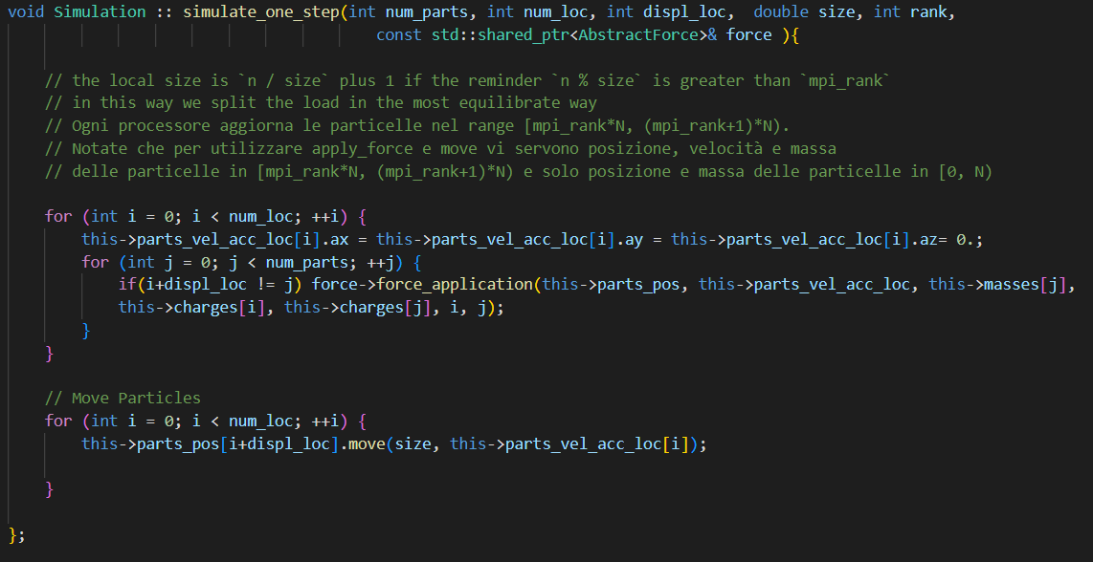
Computation and Parallelization are achieved in this way:

Slide 15
Note:
We preferred not to implement collision in MPI to keep the good featuring of sending just small chunks of particles’ velocities. (Information of velocities of all particles is needed by a process to compute the effect of an elastic or anelastic collision).
For the same reason in MPI we have chosen not to implement the optimization of the calculation of just the lower triangular part of the matrix representing interactions (while in Openmp we have implemented it).

Slide 16
Performance results on the 2D implementation:

Slide 17
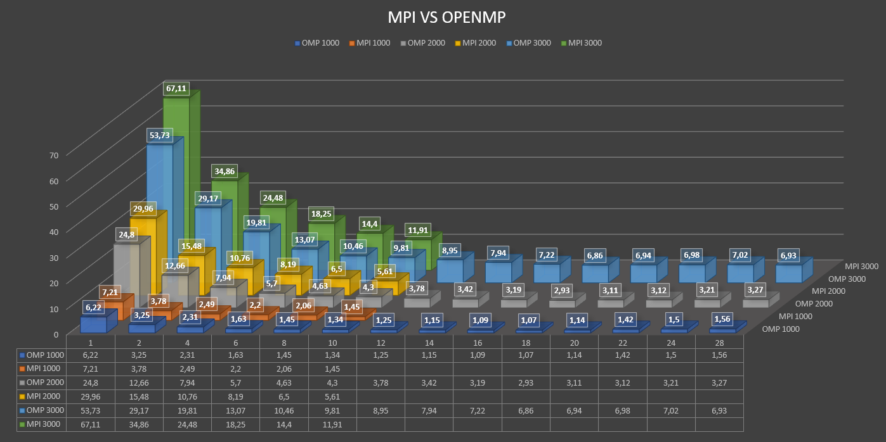
Performance results on the 2D implementation:

Slide 18

2D visualization (using pillow library):

Slide 19
CUDA

Slide 20
Data structure:
Particles are composed of thrust vector for both the host and the device.
Why have we used thrust vectors?
Thrust provides two vector containers, host_vector and device_vector.
The = operator can be used to copy a host_vector to a device_vector (or vice-versa). The = operator can also be used to copy host_vector to host_vector or device_vector to device_vector. Individual elements of a device_vector can be accessed using the standard bracket notation. However, each of these accesses requires a call to cudaMemcpy.
All algorithms in Thrust have implementations for both host and device.
thrust::copy can copy data between host and device. Hides cudaMalloc and cudaMemcpy.
Why we need dx = thrust::raw_pointer_cast(vy.data()) ?
Because we can’t pass a thrust device vector to the kernel because thrust device vector standard bracket notation is an host function, so we need to pass a pointer to that vector.

Slide 21
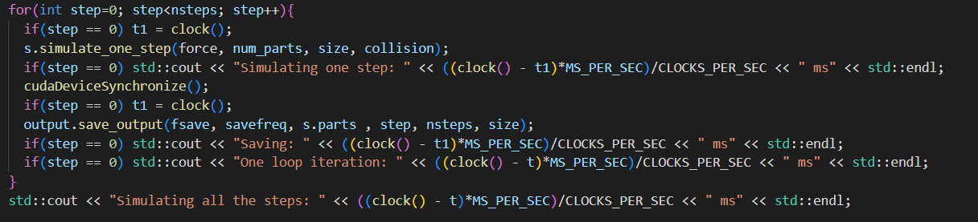
Synchronization :
We synchronize at each step after the call to simulate_one_step with CudaDeviceSynchronize() (as with #pragma omp barrier, MPI_Barrier(MPI_COMM_WORLD) ).
And inside simulate_one_step after each call to force_application (as it was done in openmp).

Slide 22
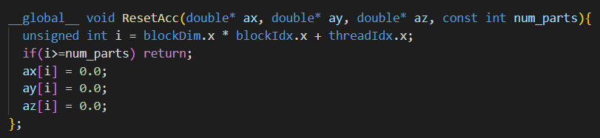
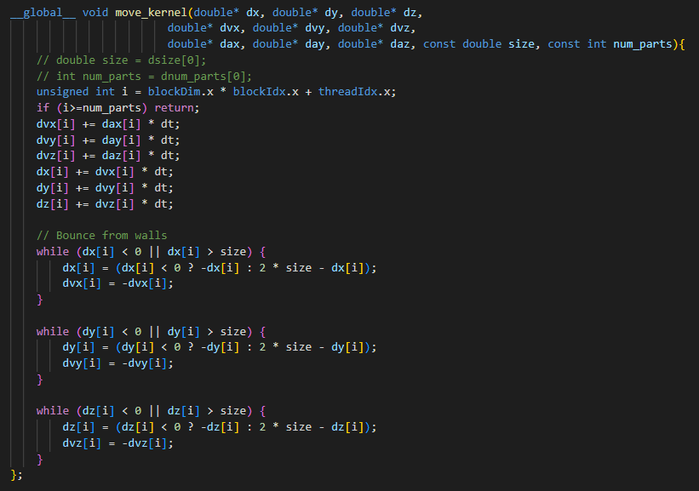
Kernel functions in AllParticles
Note that class members are declared as normal host function but in their definition there is a call to a kernel function defined in the same cpp file.

Slide 23
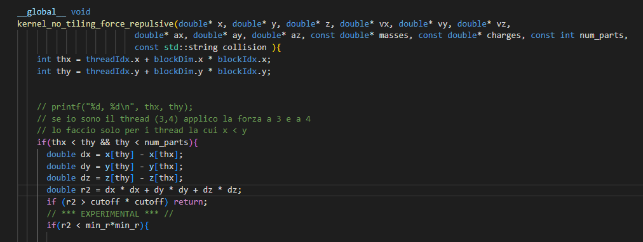
Kernel functions in Simulation :
Simulate_one_step calls force_application that is a method of PhysicalForces class that execute a different kernel for each type of force.
Optimization in force calculation:
The calculation of forces was optimized exploiting the Newton’s law of action and reaction: the computation is performed just for the lower triangular part of the matrix representing force-interactions between each particle, the upper part is automatically deduced adding a minus sign.

Slide 24
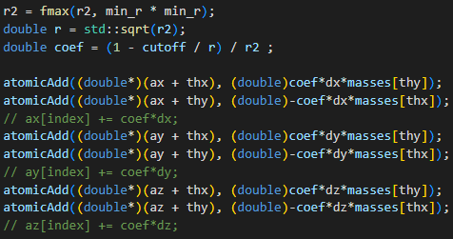
Concurrency:
in the kernels that compute resulting forces we concurrently access same memory locations to perform the write: an atomic add is needed to avoid data races.

Slide 25
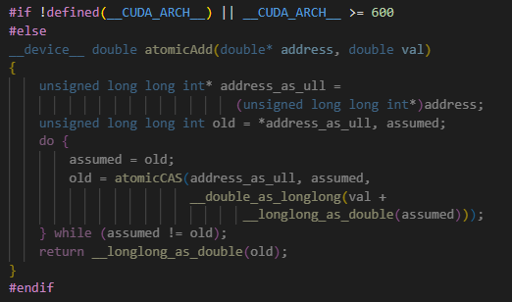

Slide 26
Optimization in init() function:
Thanks to thrust we could initialize all device vector’s element accessing them directly from the host function. However this would require the slow operation of cudaMemcpy for each single element.
So, instead of accessing device elements one at a time in order to initialize them, it was preferred to initialize first the host vector and then copying all the entire initialize host vector into the device one with thrust::copy. This alternative is much more efficient because do the transfer in batched fancy better exploiting bandwidth.

Slide 27
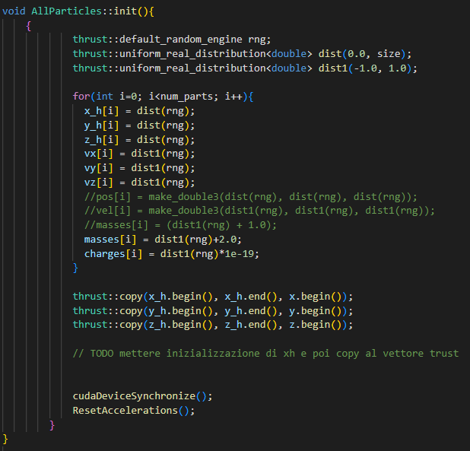

Slide 28
Optimization: tiles
The vertical dimension shows the parallelism of the 1D grid of N/p independent thread blocks with p threads each. The horizontal dimension shows the sequential processing of N force calculations in each thread. A thread block reloads its shared memory every p steps to share p positions of data.
We have taken the dimension of the tile equal to the dimension of the block.
At each step of the computation it is loaded into the shared memory the information about two little sequences of particles (each of length equal to the x dimension of the block). The info loaded is about the position, velocity, acceleration, mass, charge of that little sequence of particles. At each step are calculated the interactions between each particle of the two sequence. The resulting acceleration is added to the partial one. It is taken into account that, for optimization, the interactions of the upper triangular part of the matrix (representing the interactions) are not calculated as can be easily deduced from the upper triangular part of the matrix.

Slide 29
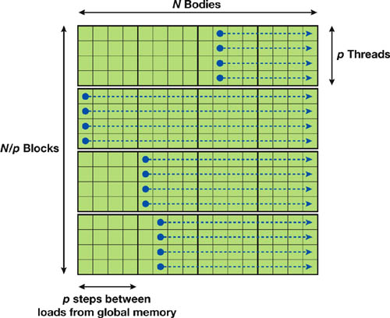

Slide 30
Optimization: stringstream
Most of the time taken by the program is that used to save on file.
A first optimization was to save all the update on a buffer and just in the final step transfer it to the file (instead of saving on file at each step).
Moreover instead of writing to ofstream one by one directly
for (int i = 0; i < 10000; ++i) {file << x[i] << “ “ << y[i] << “ “ << z[i] << “\n” ;}
we write to a stringstream first, and then write to ofstream at once
ostringstream strstream;
for (int i = 0; i < 10000; ++i) {strstream << << x[i] << “ “ << y[i] << “ “ << z[i] << “\n” ;}
ofstream file("c:\\test.txt");
file << strstream.str();
The second approach is faster because flushing to a string buffer will be much faster than flushing to the disk and each time there is a std::endl instead of '\n', std::endl flushes the buffer to disk.

Slide 31
Optimization: Newton’s law
It was not implemented the optimization of the calculation of just the lower triangular part of the matrix representing interactions (while in Openmp we have implemented it). This decision was taken accordingly to a study of the performances.
In this case Cuda run faster even if there are more calculations because of control divergence of the threads in a warp. The maximum performances in Cuda are obtained when all threads in a warp execute the same instructions, so they can be run by the SM all in parallel.
With Newton’s law the overall time would be increased by a factor of 5.

Slide 32
Performance results on the 3D implementation:

Slide 33
Performance results on the 3D implementation:

Slide 34
Performance:
On the overall time of our experiments the time needed to transfer the three buffers from GPU to CPU is negligible.
Time taken by CUDA on 1000 particles is half to the time taken by OPENMP.
However on 2000 particles CUDA takes much more time than OMP.

Slide 35
Note 1: As we have the same type for position, velocity and acceleration and they are all in 3D, it is possible to use double3 instead of three doubles. Double3 is a CUDA vector type derived from the double type. Basically it is a struct of three doubles. Note 2: Unique pointer were preferred to shared pointers because they don’t introduce communication overhead. Indeed in the serial, openMP and MPI implementations only unique pointers appear (std::unique_ptr<AbstractForce>). However in CUDA implementation we have (std::unique_ptr<AllParticles> and) std::shared_ptr<AbstractForce>. The shared pointer in this case is necessary because not only the class AllParticles own the pointer to AbstractForce. Indeeed Simulation own the pointer to AllParticles which has as a member the pointer to AbstractForce.

Slide 36
Note 3: possible improvement using openGL The performance of the renderer can be improved by eliminating the need to save on file. This could be done using OpenGL vertex buffer. A more recent approach to this performance issue would be to use a general purpose GPU programming language (GPGPU) like nVidia’s CUDA or the open standard OpenCL to update the particle buffer and vertex buffer directly on the GPU so that the memory never has to be moved off the GPU.

Slide 37
Sources:
https://www.3dgep.com/simulating-particle-effects-using-opengl/
https://www.nvidia.com/content/GTC/documents/1055_GTC09.pdf
https://ec.europa.eu/programmes/erasmus-plus/project-result-content/17c9af58-78ac-4276-abd6-25cace51f780/lec09-nbody-optimization.pdf
https://docs.nvidia.com/cuda/thrust/

Slide 38
Repulsive force

Slide 39
Gravitational force

Slide 40
Gravitational assist force

Slide 41
Coulomb force

Slide 42
Inelastic collision

Slide 43
Anelastic collision

Slide 44
Possible optimization: Barnes Hut
For large counts, the previous method calculates of force contribution of distant particles
Distant particles hardly affect resultant force
Algorithms like Barnes Hut reduce number of particle interactions calculated
Volume divided into cubic cells in an octree
Only particles from nearby cells need to be treated individually
Particles in distant cells treated as a single large particle

Slide 45
Note 6:
If we seed c++11 mt19937 as the same on different machines, will we get the same sequence of random numbers?
The generator will generate the same values.
The distributions may not, at least with different compilers or library versions.
Python correctness check works only if the values are in the same order.

